Slide 1


A
Presentation
On
“application to locate skilled labourer for highway construction works”
SUBMITTED TO:
Ms. Shikha Shrivastava
SUBMITTED BY:
Code Warriors
Samarth Chadda

Slide 2

CONTENTS
Problem Statement
Idea/Solution
Objective of the project
Users of the project
Main components
Tools and Technologies
Screenshots
Key Learning
Conclusion

Slide 3
PROBLEM STATEMENT
During any construction it’s very challenging to procure skilled/ semi-skilled resource for the various construction activates under Highway Sector. The application will register the details of Placement Agencies dealing with various categories of skilled/ semi-skilled manpower in the highway sector. Having awarded the work, the highway contractors can access these agencies and make the necessary manpower procurement.

Slide 4
IDEA/SOLUTION
To make the procurement of various categories of skilled/ semi-skilled worker in the highway sector we have developed a web portal using html, css, php and my-sql. It includes options for placement agencies to register themselves, for this they are required to fill a registration form consisting of details of the agencies and their workers. Based on their requirements highway contractors can contact the desired placement agencies for hiring the workers. To facilitate the users the portal also consist of ‘Contact Us’ and ‘FAQs’ sections.

Slide 5
OBJECTIVE OF PROJECT
To provide employment to workers.
To fulfill the requirements of workers during highway construction.
To provide a digital platform to contractors so that they do not have to search for workers.
To increase opportunities for various skilled and semi-skilled workers to get work and that too with a good pay.
To help placement agencies to extend their services.

Slide 6
USERS OF THE PROJECT
Highway Contractors : Highway contractors can use it for fulfilling their requirements of highway workers in any construction work.
Placement Agencies : Placement agencies can use this portal as their extended hand for procuring the demanded workers in any highway construction work.
Website Managers : To remove any discrepancies.
Workers : Though the workers are not much literate to use the portal but are surely the foremost beneficiaries of the project.

Slide 7
MAIN COMPONENTS
HOME
PLACEMENT AGENCIES
HIGHWAY CONTRACTORS
CONTACT US
REGISTER
LOGIN
REGISTER
LOGIN
FAQs
DISPLAY
REGISTERATION FORM (Details of Workers)
FEEDBACK
DATABASE

Slide 8
TOOLS AND TECHNOLOGIES
The tools and technologies used in this project are:
HTML
CSS
My-SQL
PHP

Slide 9
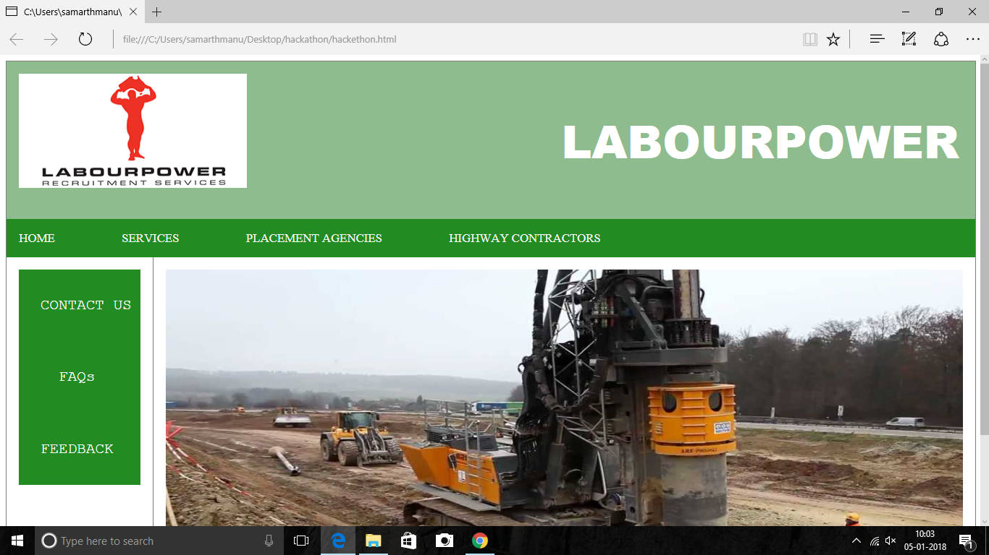
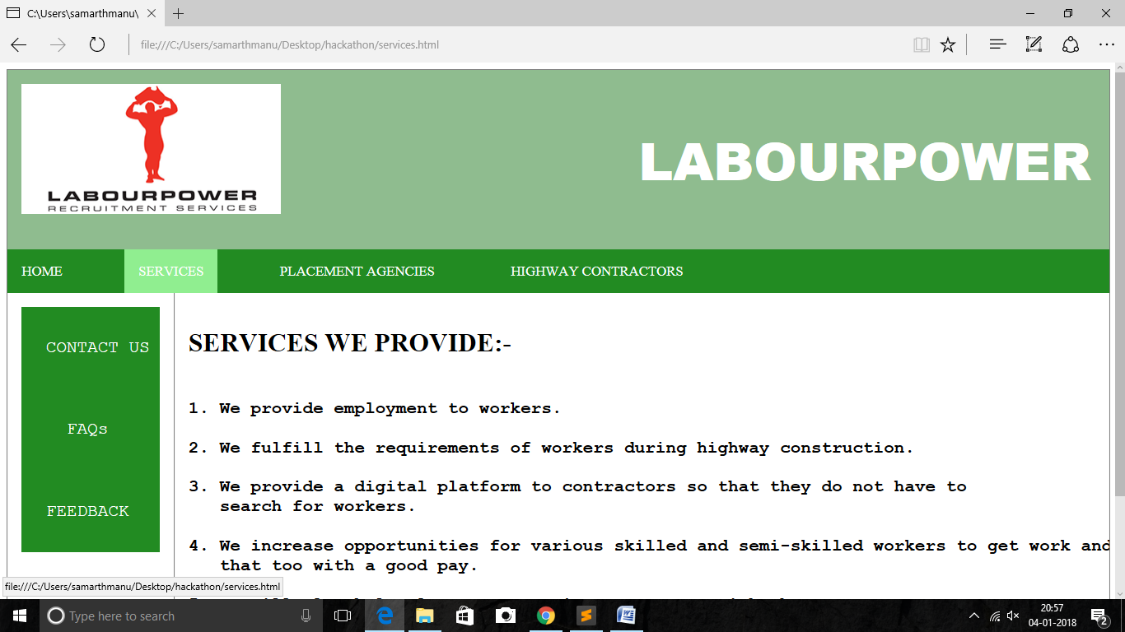
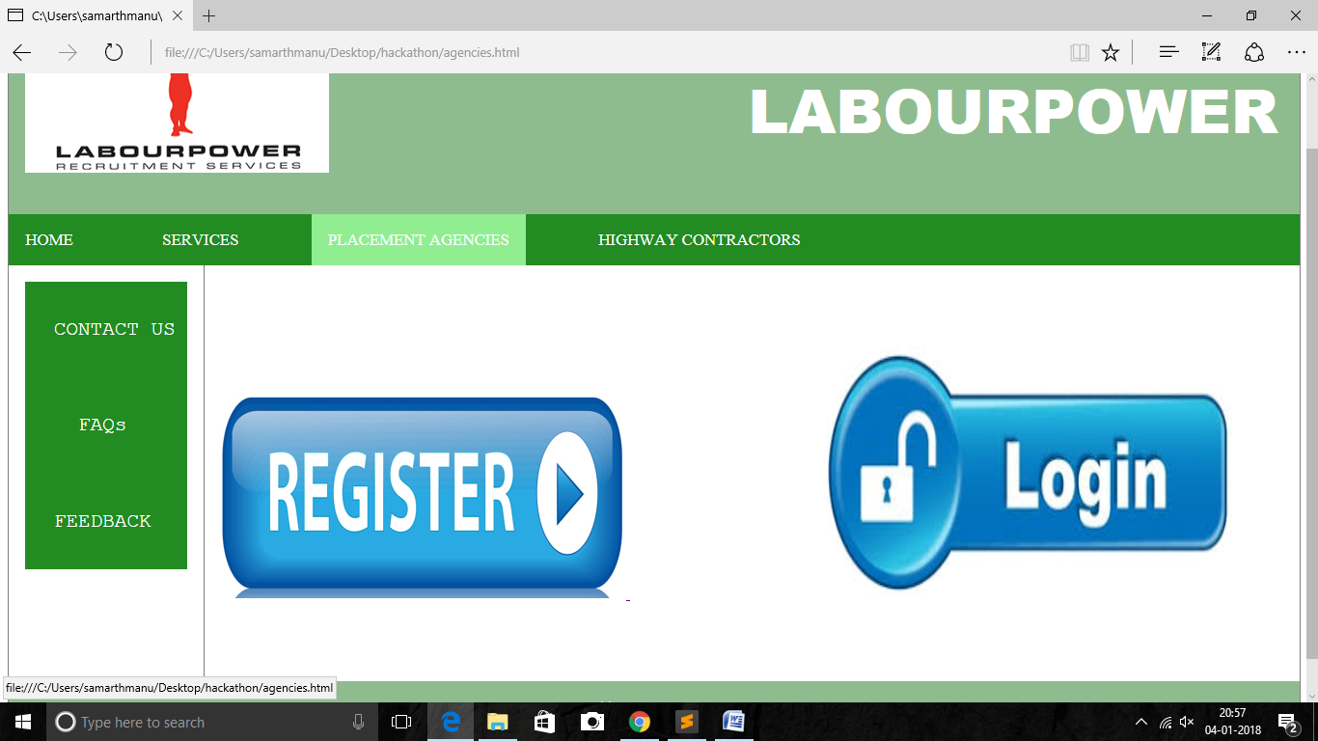
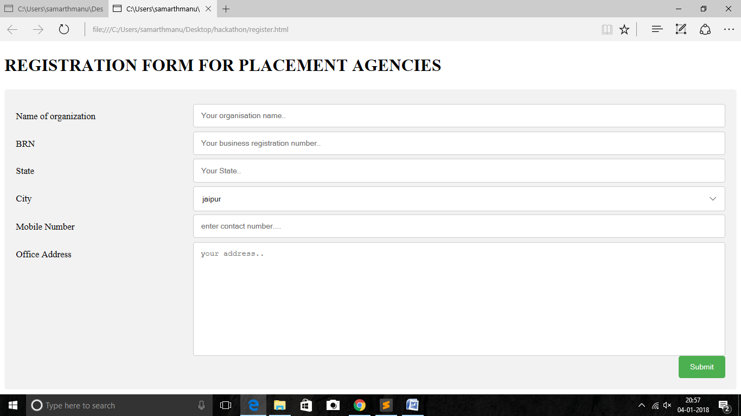
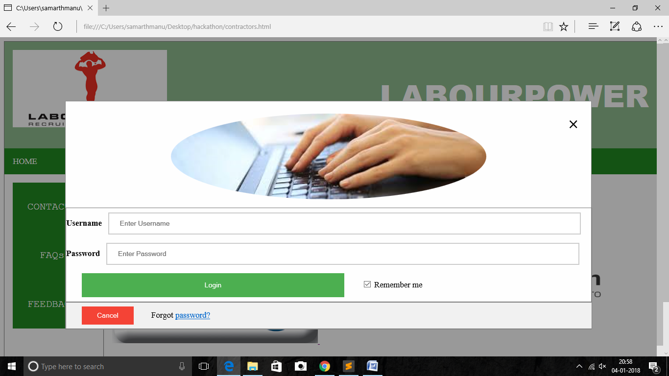
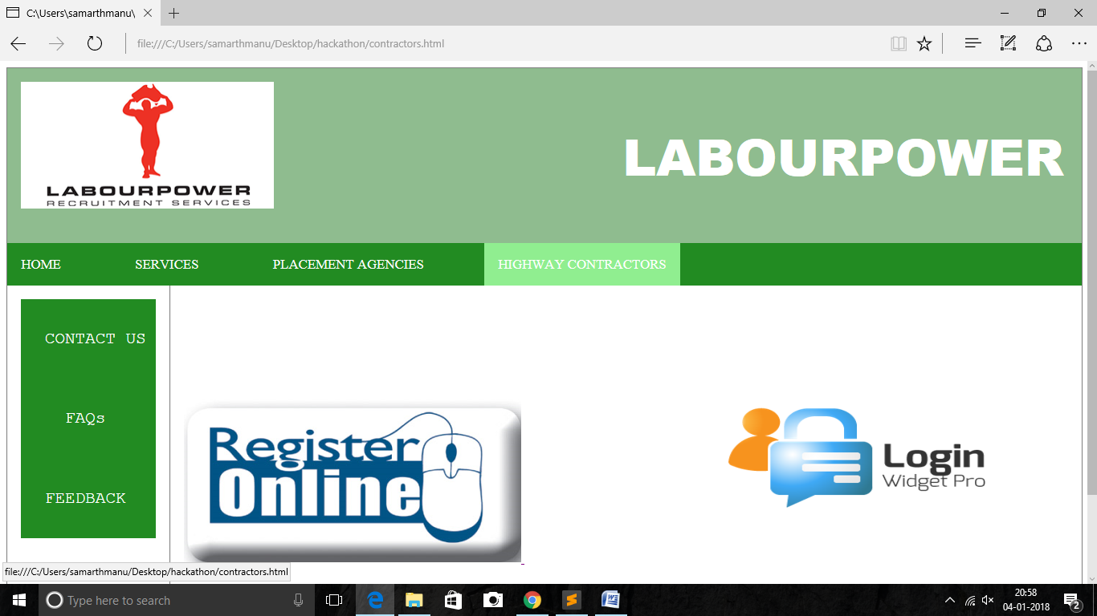
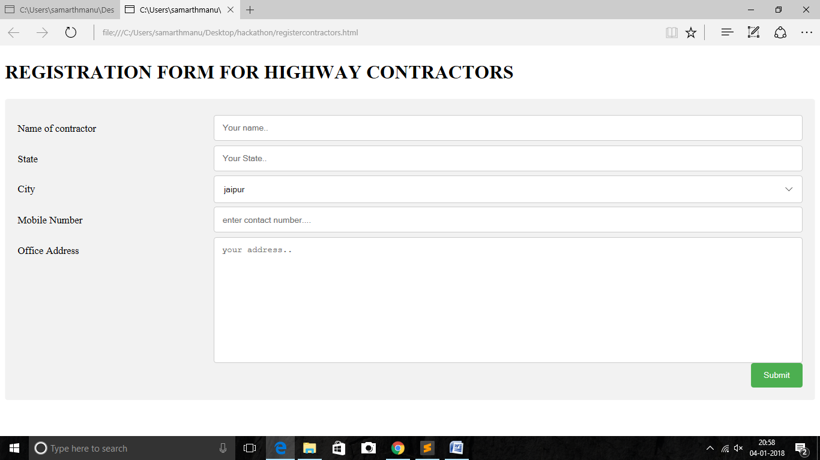
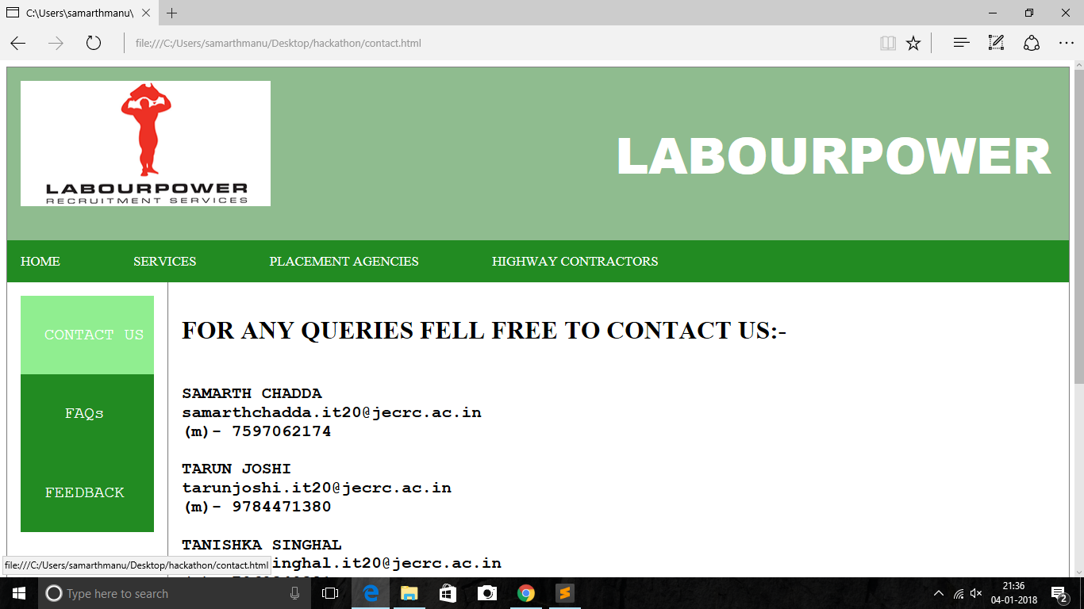
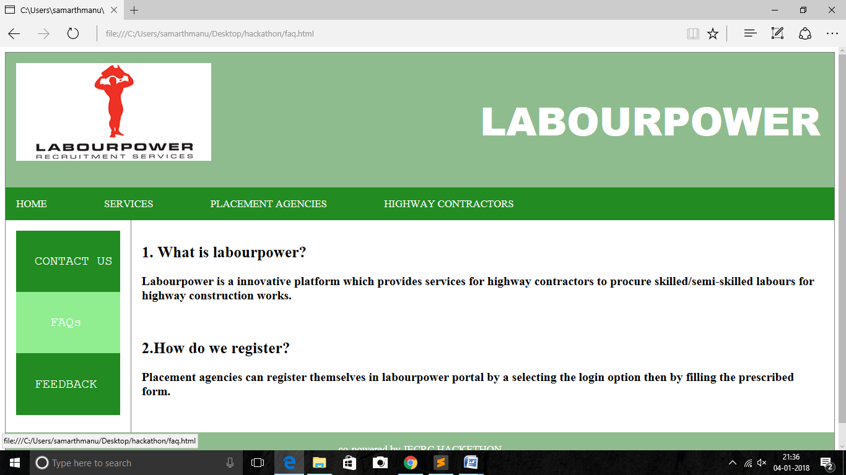
SCREENSHOTS

Slide 10
KEY LEARNING
Working on this project helped us in :
Learning the basic web development components such as HTML, CSS and PHP.
Learning the concepts of My-SQL for data storage.
Understand the procedure of presenting and organizing web pages.
Knowing the challenges in highway construction work in India.
Getting an experience of teamwork and mutual coordination.

Slide 11
CONCLUSION
India is a developing nation and various roads and highway projects are ongoing and many are proposed to be started across various parts of our country. But lack of highway workers is one of the biggest challenge in the way. So to overcome this problem the project will help to some extent by facilitating the procurement of manpower.

